Slide 1


vs
Featuring 3 NEW Super Powers!

Slide 2
3
Comics Sold Per Person

Slide 3
Super Power #1
Collecting Data

Slide 4



Let’s Go Scrape Data

Slide 5
Scraping Data
Monthly Comic Book Sales
1998-2017, all Marvel and DC comics and paperbacks
509 publishers, 15,709 titles
Box Office Sales
1978-2018, Marvel and DC franchise
79 movies, 30 DC, 49 Marvel

Slide 6
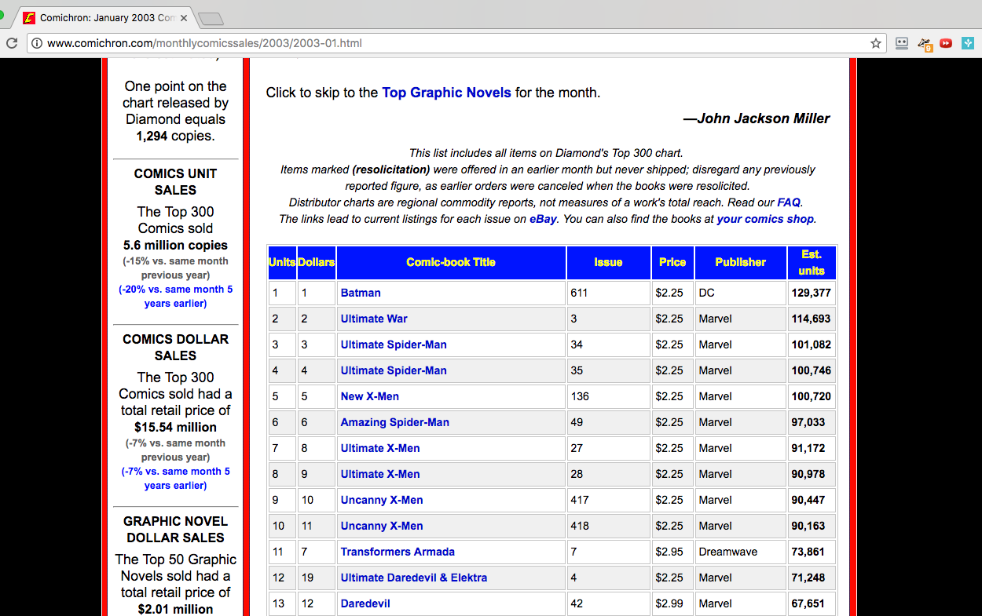
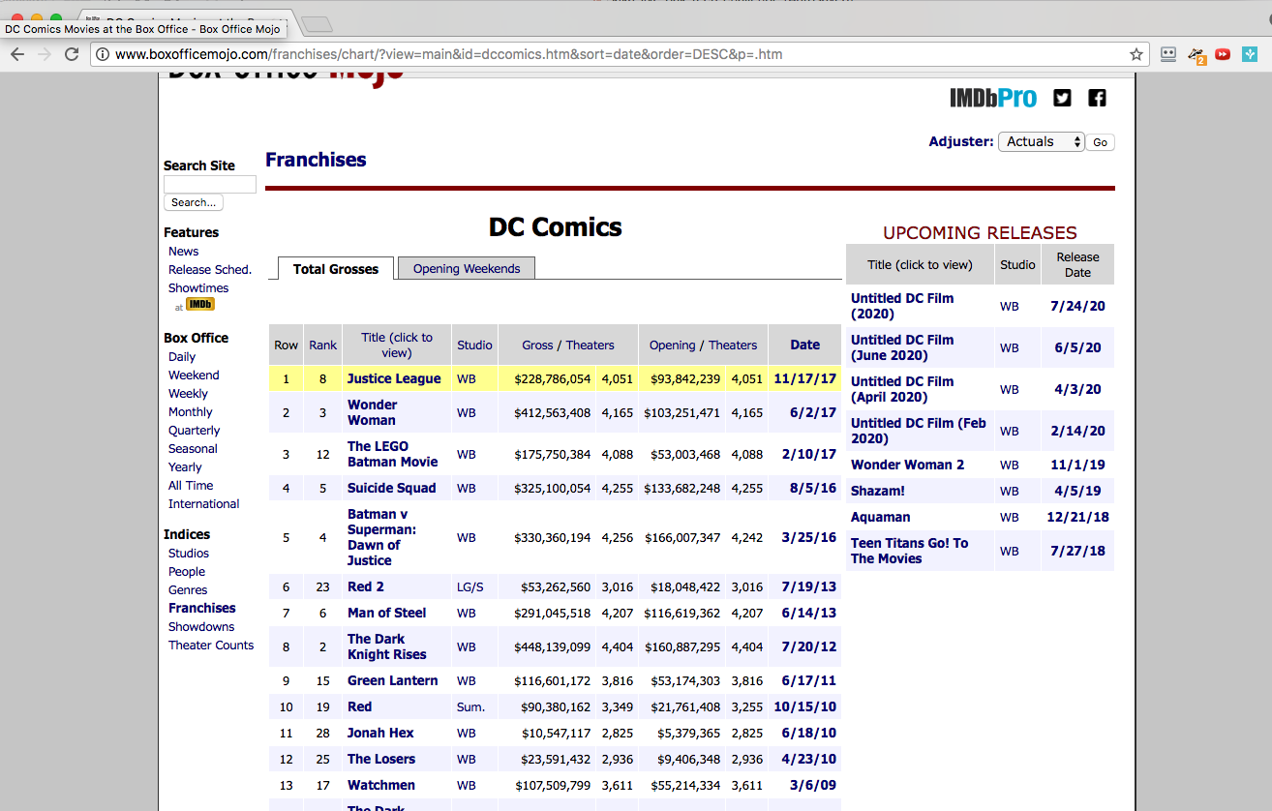
Comichron
Box Office Mojo
Villains Include:
defining universes,
Java,
and webmasters

Slide 7

Super Power #2
Charting Data

Slide 8
Comic Book sales
Comic Books Sold:
Total Sales:
1,186,934,920
$3,927,988,821
3,197 Titles
55% of Comics Sold
$693k/Title
2,987 Titles
45% of Comics Sold
$573k/Title

Slide 9
Box office Sales
Tickets Sold:
Total Sales:
2,139,963,898 $15,200,133,923
49 Movies
64% of Tickets Sold
$ 213m/Movie
30 Movies
36% of Tickets Sold
$159m/Movie

Slide 10
Movie Bump!

Slide 11
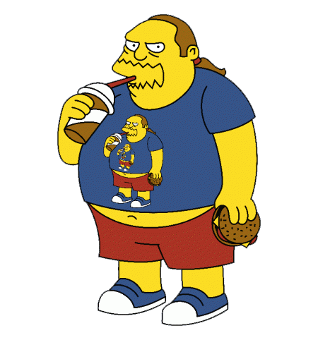
Super Power #3
Compass Reading
Where Can We Go Next?

Slide 12
Super Power #3
Compass Reading
Where Can We Go Next?
Marvel APIs
Cross Promo
Analyses
Paired Analyses

Slide 13

Super Power #4
Taking the best questions ever.
Kian Kamyab
ki@nkamyab.com

Slide 14

Side Kicks
Live Oak Bank
https://www.boxofficemojo.com
https://www.comichron.com
Presentation template by SlidesCarnival

Slide 15
Appendix
 | A | B | C
Yellow | 10 | 20 | 7
Blue | 30 | 15 | 10
Orange | 5 | 24 | 16

